Slide 1
Chapter 6: The vim Editor
An Exercise in Memorizing
Your Alphabet

Slide 2
In this chapter …
ed, ex, vi, vim
vim basics
Command Mode
Input Mode
Last Line Mode
Buffers
Yanking

Slide 3
In the beginning …
There was ed … single line editor
Then came ex … had a nifty visual mode
Visual mode lead to vi
Written by Bill Joy (BSD, csh, Sun) in 1976
vi a Unix utility – so we need a free clone
elvis, nvi, vile, and vim

Slide 4
vim
We’ll be using vim - vi improved
Written by Bram Moolenaar
In our RedHat distro, we have /bin/vim
vi is just an alias to vim
Standard in just about all Linux distros
Available from www.vim.org
gVim, multi-platform

Slide 5
vim con’t
Powerful, quick text editor
Excellent for programming due to intelligent language detection
NOT a formatting tool … plain text only
Nearly limitless options and commands
Excellent tutorial - vimtutor

Slide 6
Starting vim
Syntax: vim [options] [filename]
Filename is optional
With it, it opens that file for editing
Without, it opens a default screen
Many options available, most commonly used ones are for file recovery

Slide 7
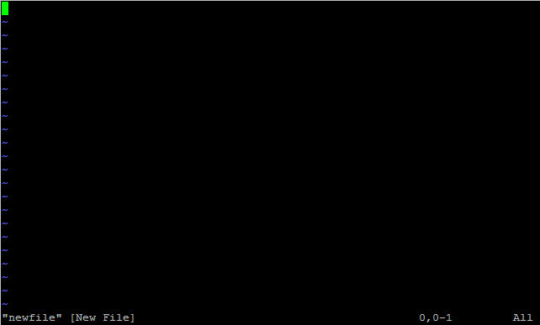
Cursor
Tildes represent empty lines
Current
column
Current line
Current buffer
(the file you’re editing)

Slide 8
How it works
vim copies the contents of the file you want to edit into memory
This memory is referred to as the Work Buffer
Changes are made to the buffer, not the file
You must write changes to file when done editing the buffer

Slide 9
Modes
vim has three modes
Command
Input
Last Line
When you start vim, you begin in Command Mode by default
Hitting ESCAPE will get you back to Command Mode from other modes

Slide 10
Command Mode
Default mode
Used to enter commands
Text manipulation
Change modes
Save/exit
Most commands are just alpha characters, not control sequences
Case sensitive!

Slide 11
Insert Mode
The mode that lets you edit and enter text
Several sub-modes
Insert
Append
Open
Replace
Change
You’ll spend most of your time here

Slide 12
Last Line Mode
From command mode press :
Cursor jumps to the last line on the screen
Here you can manage files, issue shell commands, change editor settings
Also where you go to exit

Slide 13
Getting into Input Mode
i nsert before cursor
I nsert before first nonblank character on line
a fter cursor
A t end of line
o pen line below
O pen line above
r eplace current character
R eplace characters

Slide 14
Command Mode - Essentials
h move cursor left
j move cursor down
k move cursor up
l move cursor right
x delete character
dw delete word
dd delete line
ZZ write and quit

Slide 15
Command Mode con’t
/regexpr search forward
?regexpr search backwards
n repeat last search (ie, find next result)
N repeat last search, in opposite direction
nG Jump to line n (omit n to go to last line)

Slide 16
Last Line Mode Essentials
w write file
q quit
w! write read-only file
q! quit without saving changes
e filename opens a file for editing

Slide 17
Last Line Mode con’t
sh open a shell
!command open a shell, run a command, then exit the shell
.!command open a shell, run a command, exit the shell, placing the standard output into the work buffer
Can also do !!command from Command Mode

Slide 18
Buffers
Work buffer
General Purpose Buffer – kind of like the clipboard in Windows
Named buffers
Numbered buffers

Slide 19
General Purpose Buffer
Contains recently edited or deleted text
It’s where undo information is stored
You can copy (yank) text to this buffer and then paste (put) it elsewhere

Slide 20
Named Buffers
Similar to the General Purpose Buffer
Does not contain undo info – only contains text if you put it there
Each of the 26 buffers is referenced by letter a-z

Slide 21
Numbered Buffers
Numbered 1-9
Read only
Contain most recently deleted chunks of data greater than one line long
You can paste (put) from these buffers and use them for undoing deletes

Slide 22
yank
Copies lines of text
To yank a line, use yy
Or use Y – it’s shorter
To yank multiple lines, place cursor on the first line and use nY, where n is the number of lines to yank

Slide 23
yank con’t
By default it yanks text to the General Purpose Buffer
To place in a named buffer, precede the yank command with double quotes and the letter of the buffer you wish to use
Use lowercase letter to overwrite, upper case to append
Ex: “c5Y would yank 5 lines to buffer c

Slide 24
put
Pastes text from a buffer into the Work Buffer
Use p to put below current line
Use P to put above current line
Again, if using a named buffer, precede with double quotes and the letter

Slide 25
vim
Just barely scratching the surface
Hundreds of commands
Command modifications
We’ll cover searching and substituting in Appendix A

